Slide 1
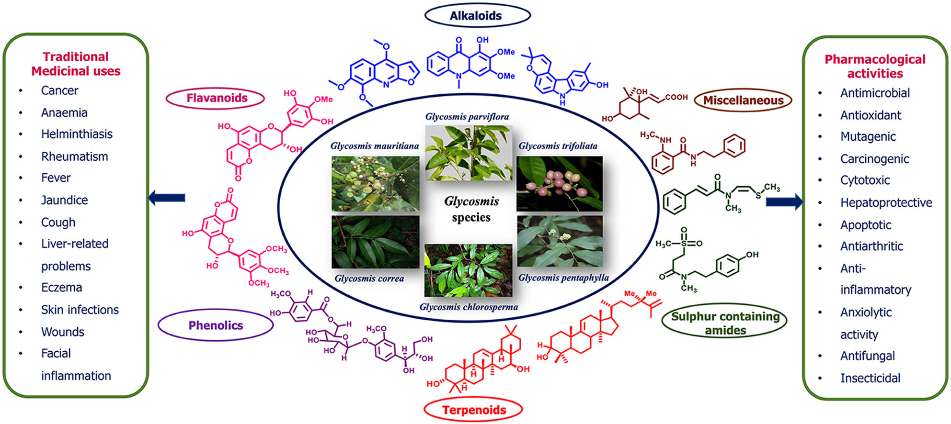
Parusu Kavya Teja.; Prachi Patel.; Drashti Bhavsar.; Chintakindi Bindusri.; Kishori Jadhav.; Siddheshwar K. Chauthe. (2021) Traditional Uses, Phytochemistry, Pharmacology, Toxicology and Formulation Aspects of Glycosmis Species: A Systematic Review. Phytochemistry, 190, 112865. https://doi.org/https://doi.org/10.1016/j.phytochem.2021.112865

Slide 2
Parusu Kavya Teja.; Jinal Mithiya.; Abhijeet S. Kate.; Khemraj Bairwa.; Siddheshwar K Chauthe. (2022). Herbal nanomedicines: Recent advancements, challenges, opportunities and regulatory overview, Phytomedicine. 96, 153890. https://doi.org/10.1016/j.phymed.2021.153890.

Slide 3
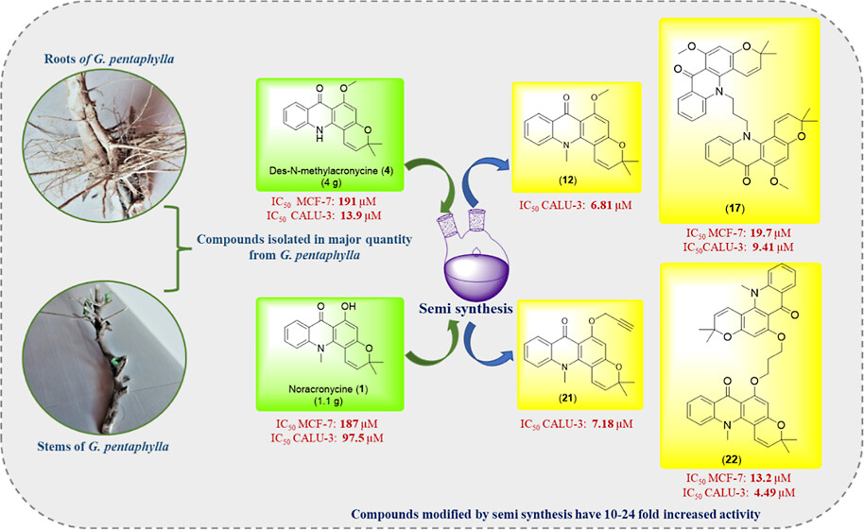
Parusu Kavya Teja.; Bao Q. Ly.; Dhaval K. Shah.; Siddheshwar K. Chauthe. (2023). Isolation, Characterization of Undescribed Alkaloids, and Semisynthetic Modifications of Cytotoxic Pyranoacridone Alkaloids from Glycosmis pentaphylla, ACS Omega. doi.org/10.1021/acsomega.2c08100.

